Slide 1

PELE

Slide 2
Outline
PELE:
Methodology
Applicability domain and examples
AdaptivePELE:
Methodology
Applicability domain and examples
Hands on

Slide 3
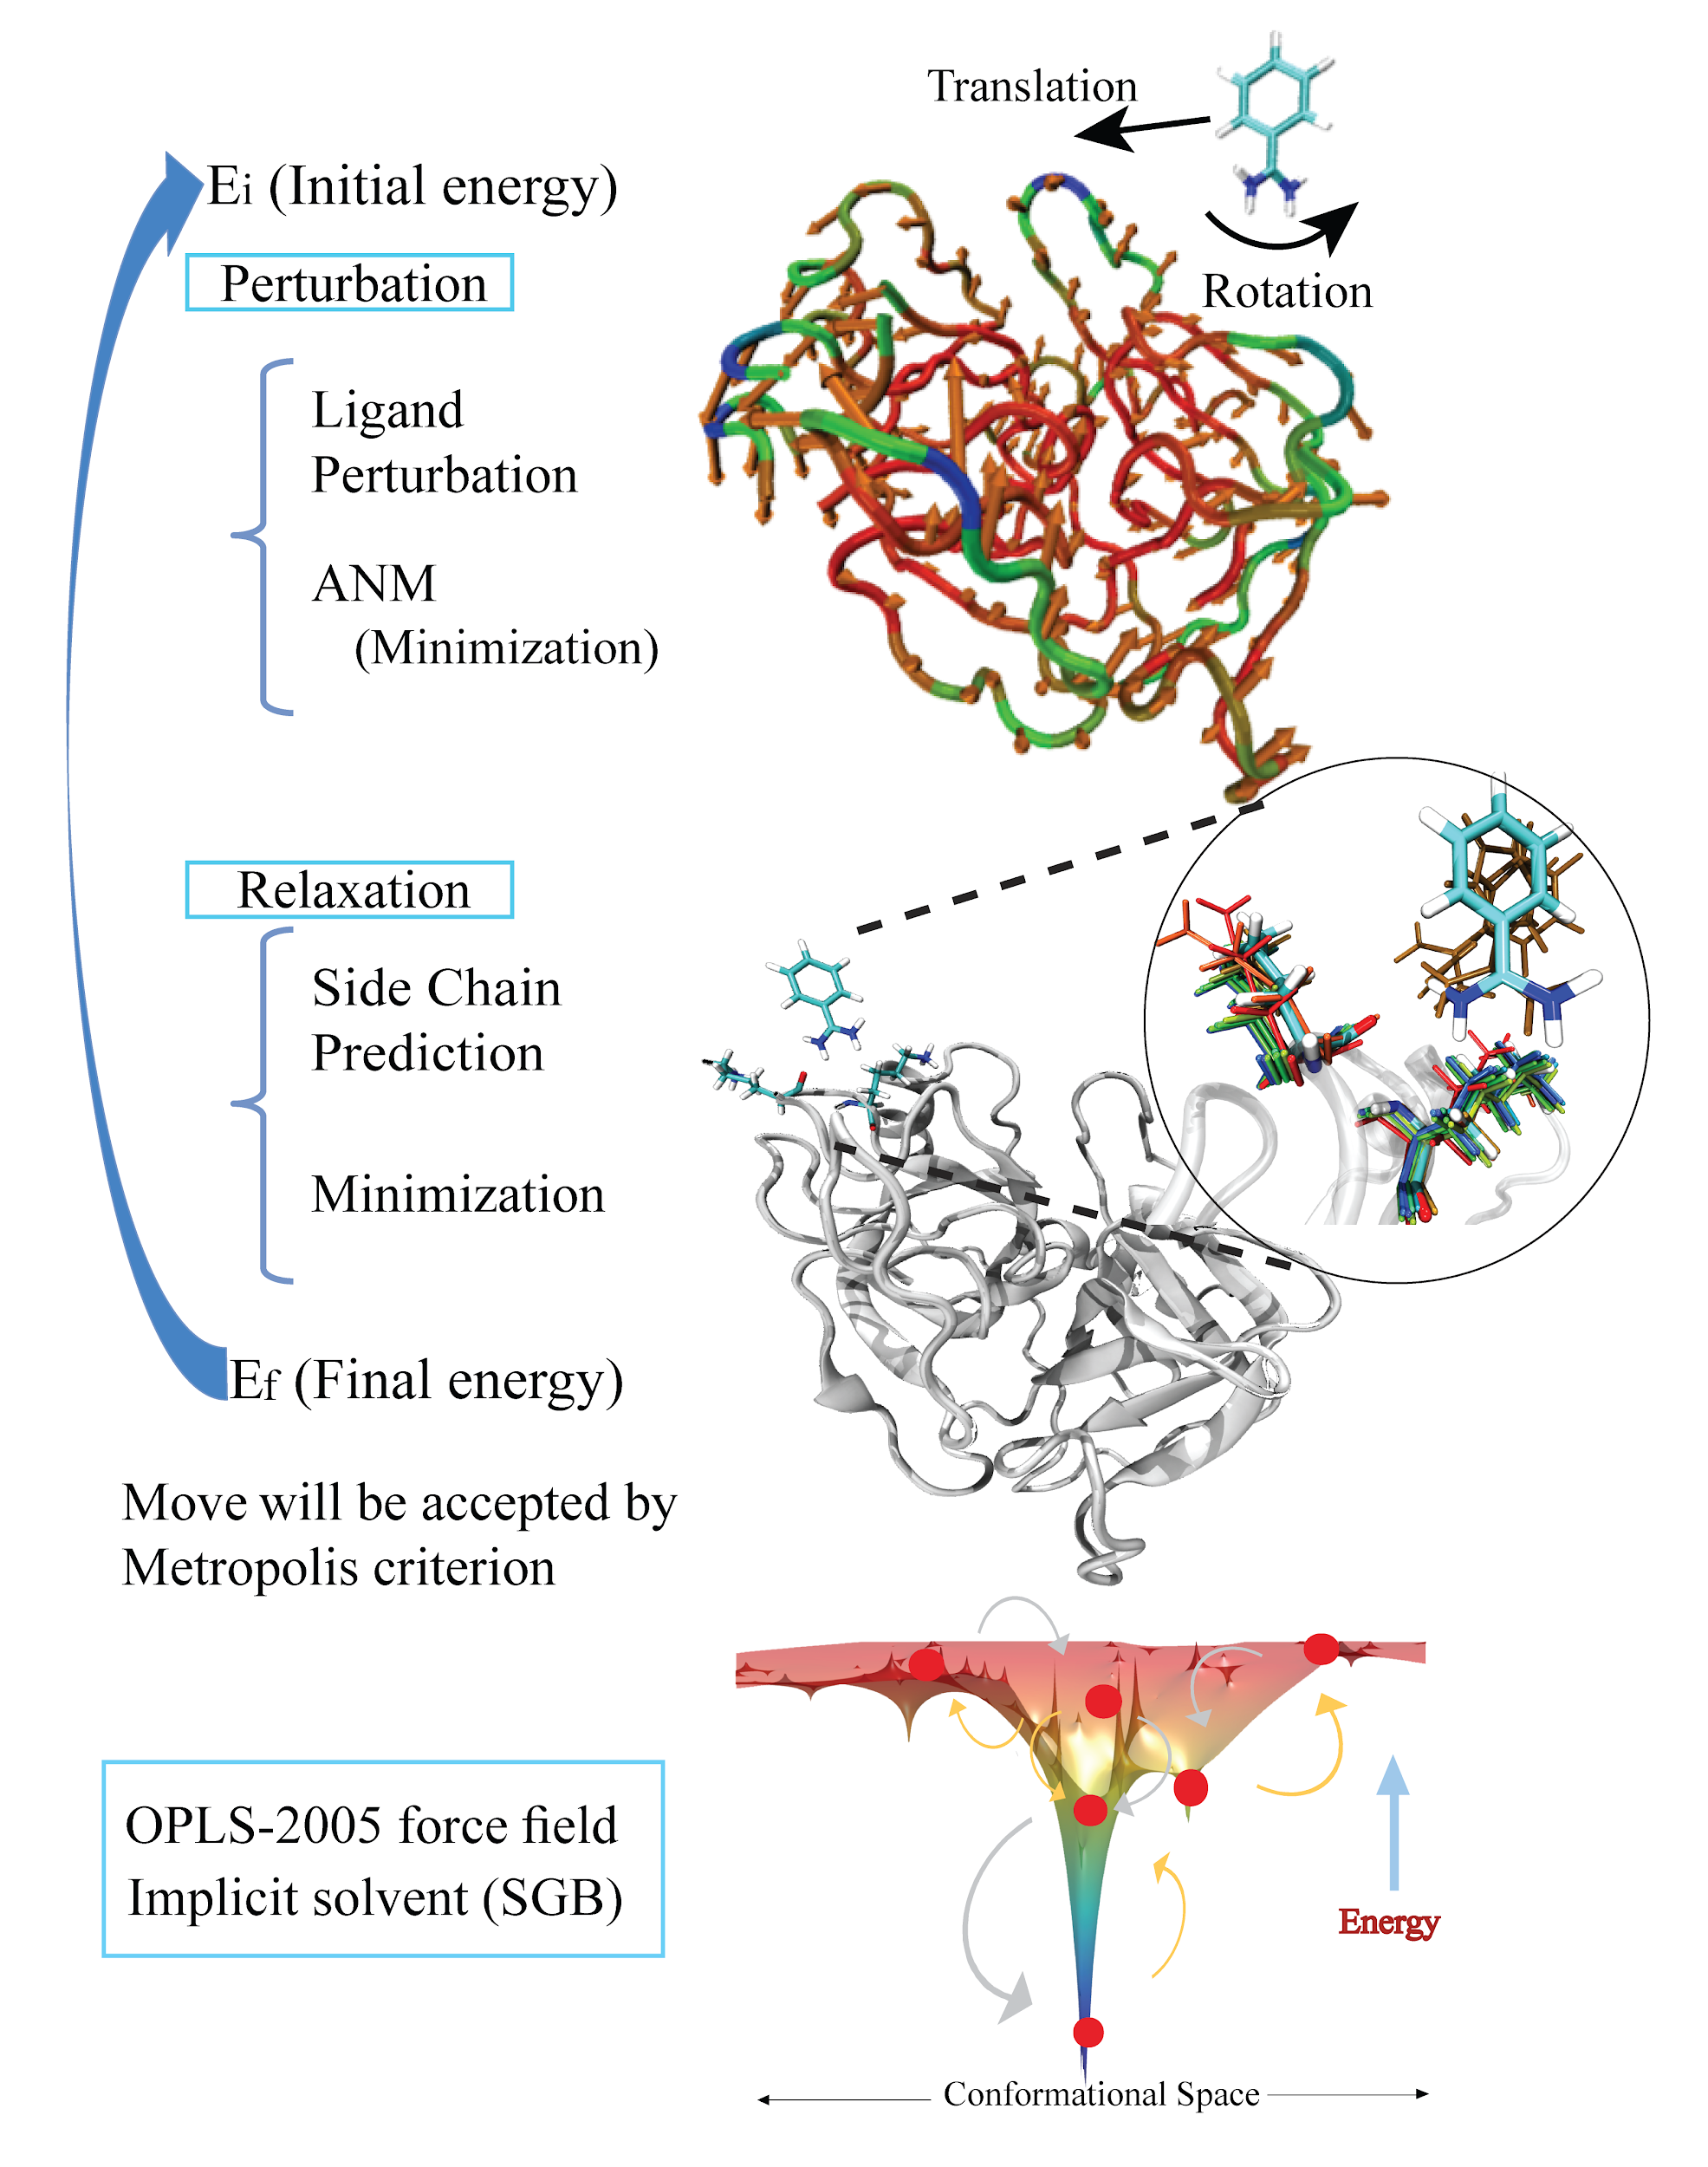
Methodology

Slide 4

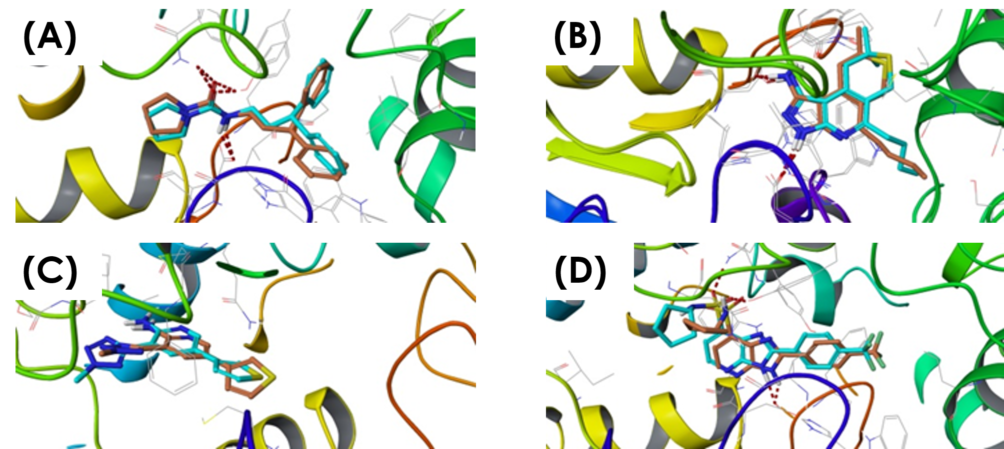
Applicability Domain
Induced fit Simulation: Improving docking poses by induced fit PELE
https://pubs.acs.org/doi/abs/10.1021/acs.jcim.5b00744

Slide 5

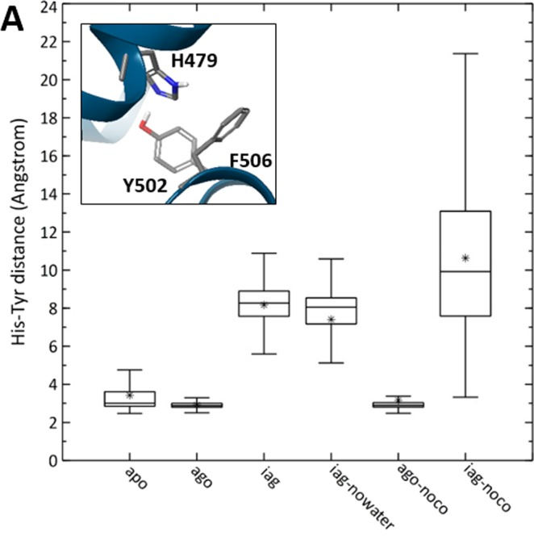
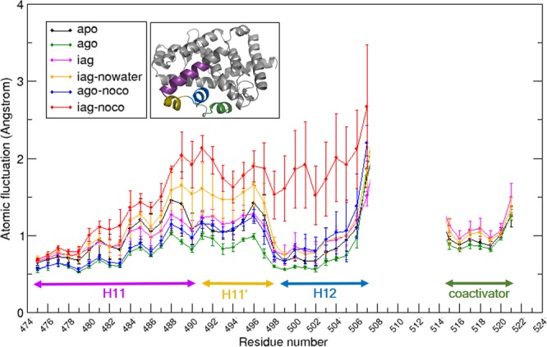
Applicability Domain
2. Out In: Entrance Path
https://www.ncbi.nlm.nih.gov/pmc/articles/PMC6872664/

Slide 6
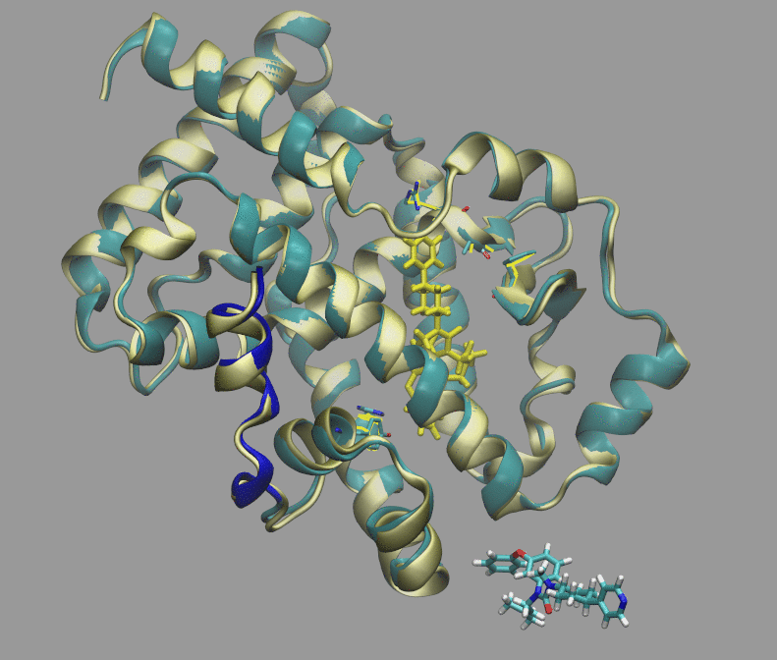
5vb7 Agonist

Slide 7

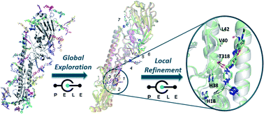
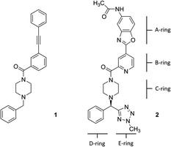
Applicability Domain
3. Global Exploration: Pocket identification
https://pubs.rsc.org/en/content/articlelanding/2020/RA/D0RA01127D#!divAbstract

Slide 8
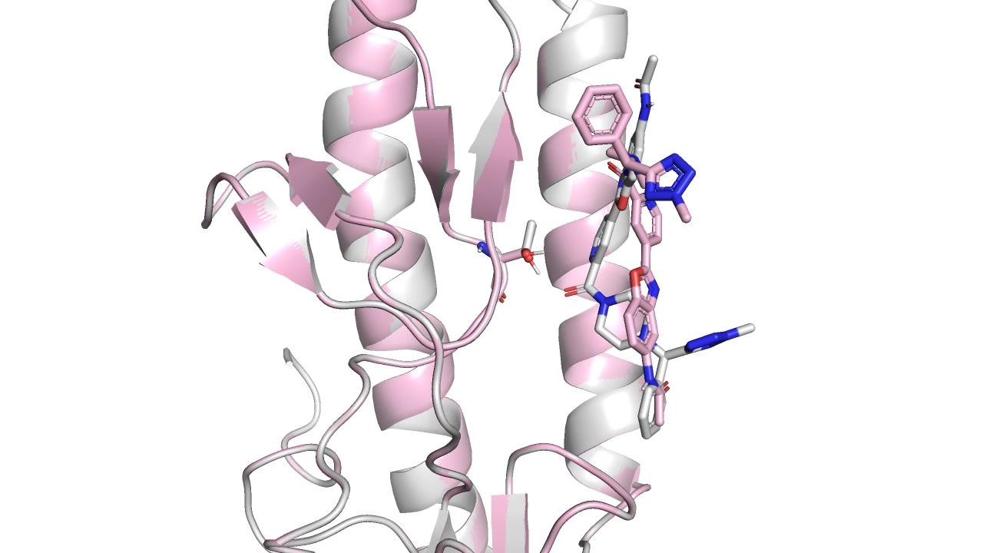
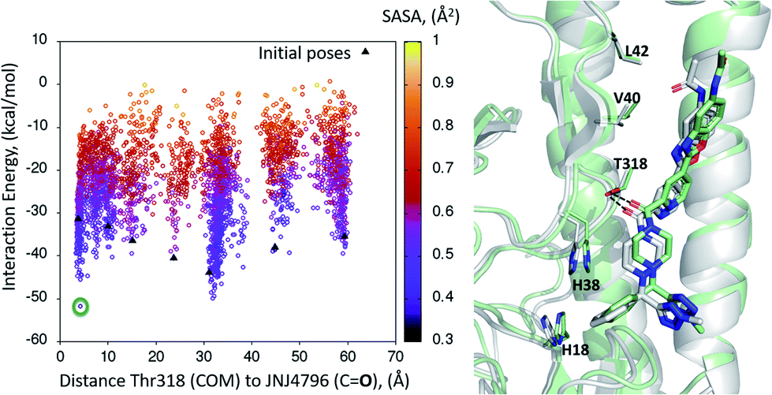
JNJ7918

Slide 9
Recap - Applicability Domain of PELE
Induced fit Simulation → Docking refinement
2. Out In Simulation→ Entrance Path or targets where docking is not possible
3 Global Exploration → Pocket identification

Slide 10
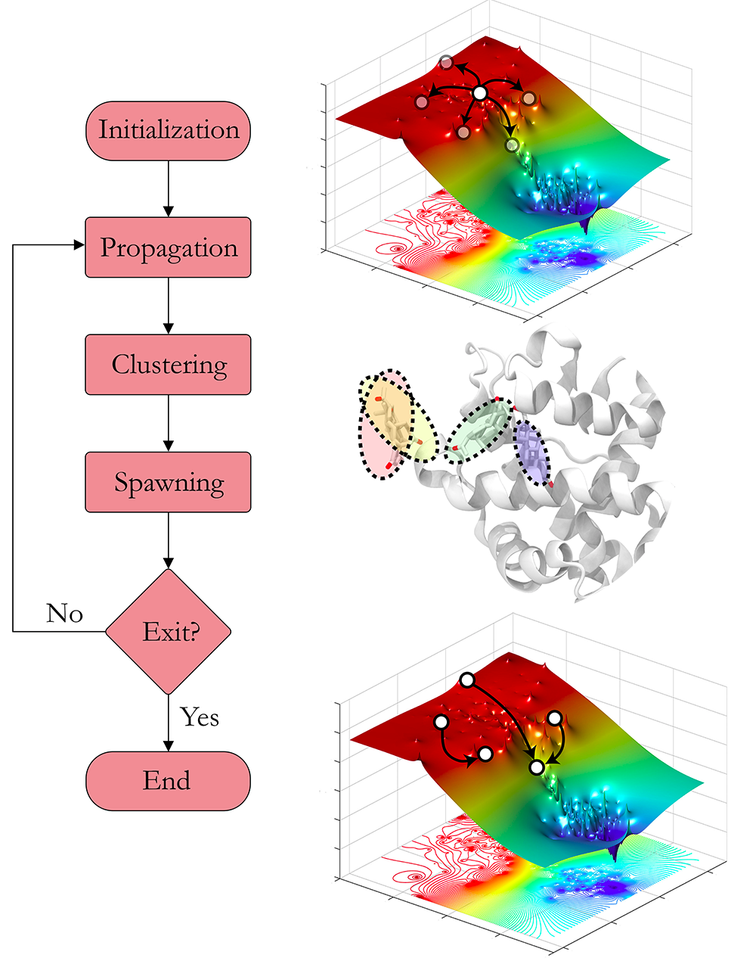
AdaptivePELE

Slide 11
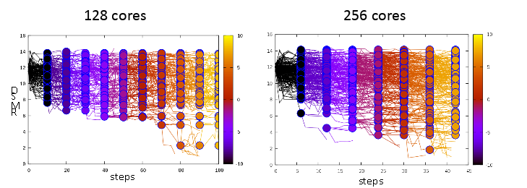
RMSD

Slide 12
RMSD

Slide 13
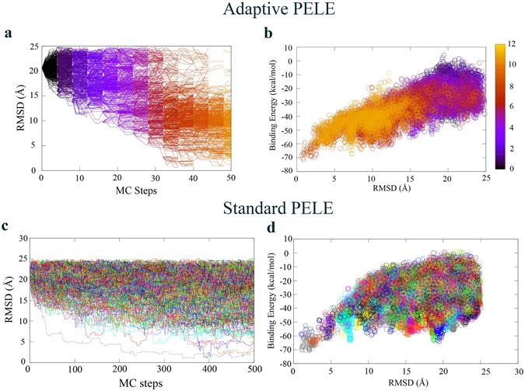
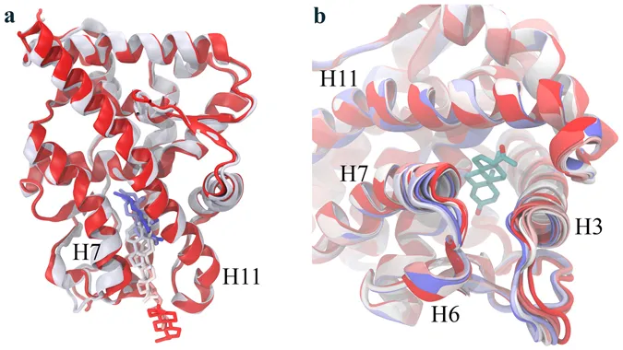
Applicability Domain
Biased Simulation: Obtain similar results as PELE 20 times faster
http://www.nature.com/articles/s41598-017-08445-5

Slide 14
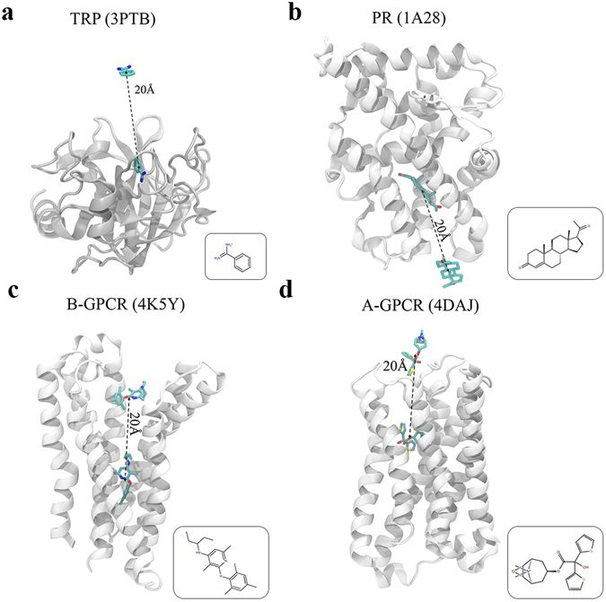
Adaptive simulations, towards interactive protein-ligand modeling

Slide 15

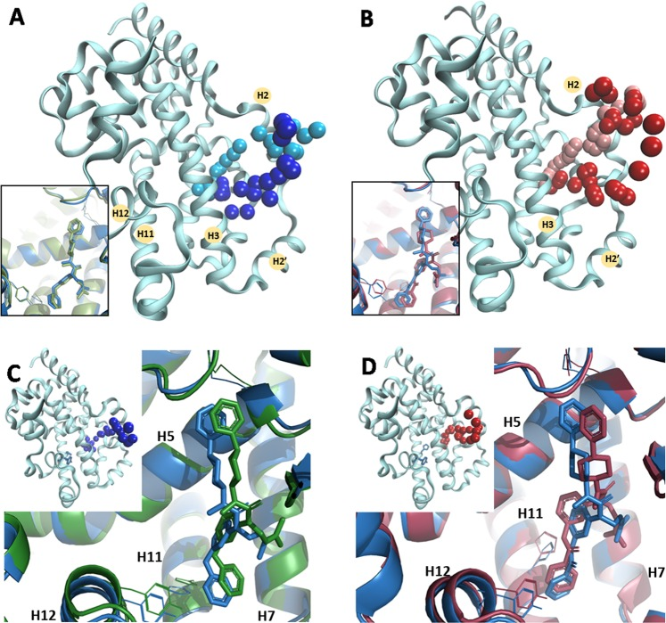
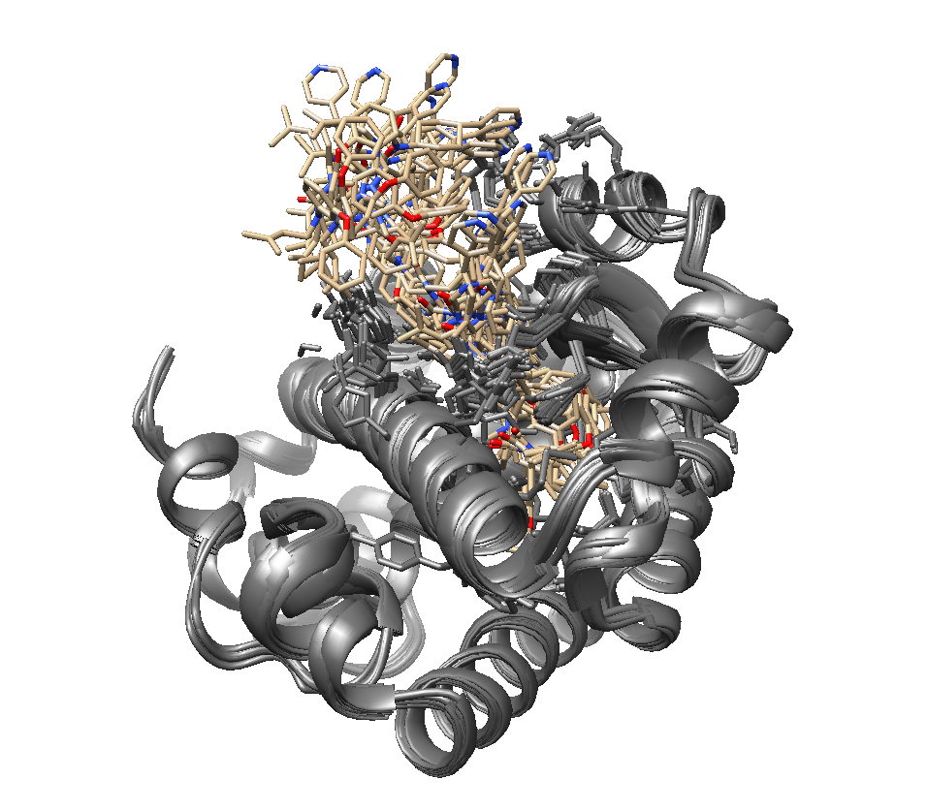
Applicability Domain
2. Exit Simulation: Understand the dissociation path
http://www.nature.com/articles/s41598-017-08445-5

Slide 16
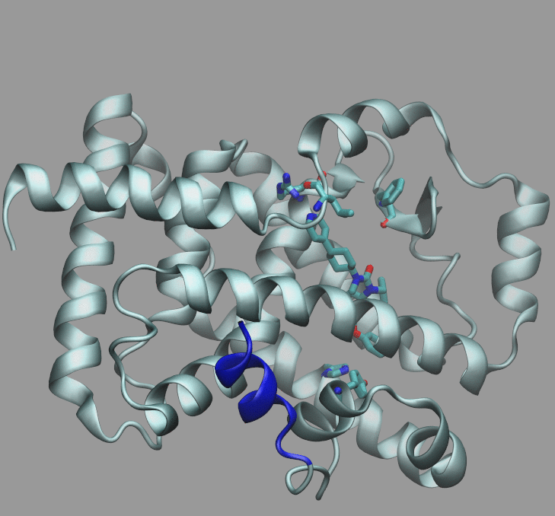

Slide 17
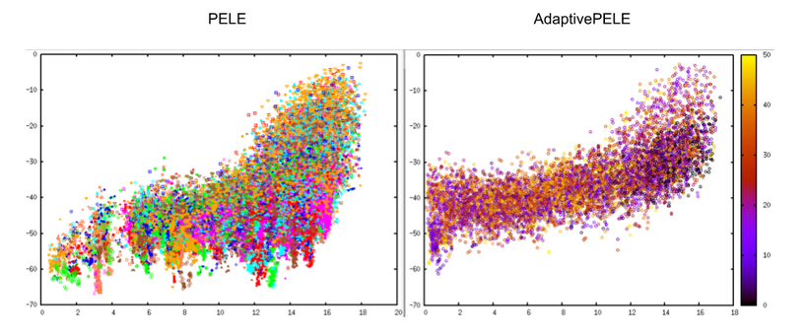
When to use AdaptivePELE or PELE?
AdaptivePELE main pro: Faster Global and induced fit exploration
AdaptivePELE main con: You may lose minimums along the simulation as in the figure below

Slide 18
Recap - Applicability Domain of AdaptivePELE
Biased Simulation: Obtain similar results as PELE 20 times faster
Exit Simulation: Understand the dissociation path

Slide 19
NEW FEATURES
Fragment Growing → B Testing
Water-PELE → Production: Trying to build a “watermap”
Msm-PELE → Production: Trying to improve results

Slide 20

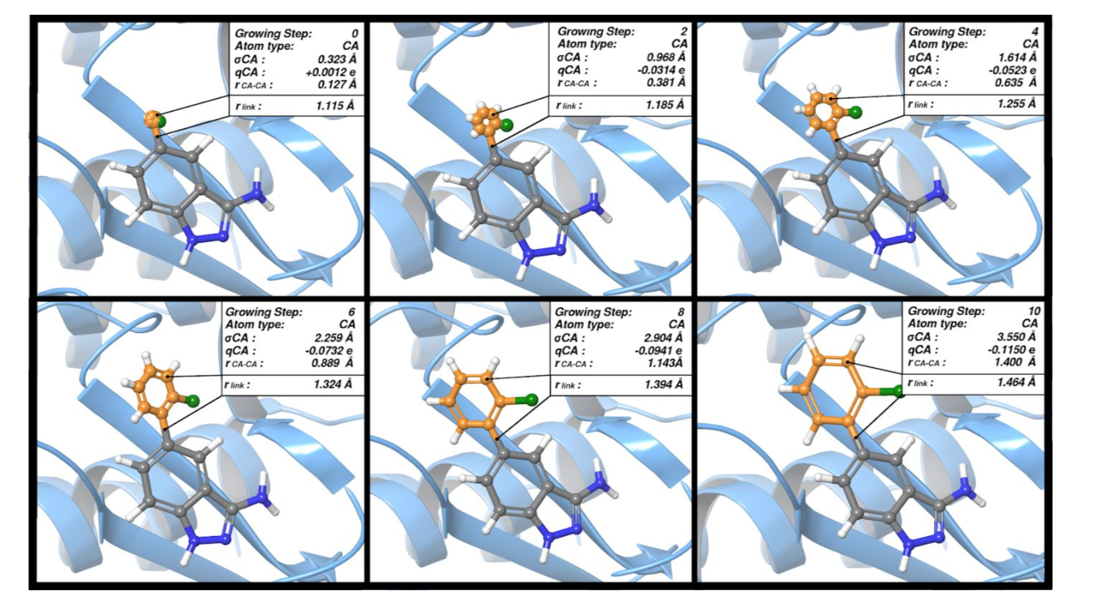
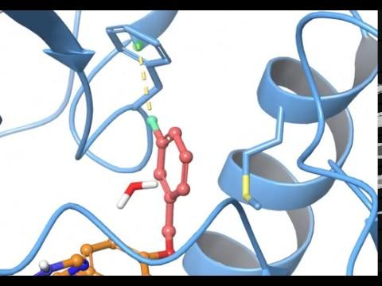
New Features
Frag-PELE: Dynamic ligand growing within a binding site. A novel tool for hit-to-lead Drug Design.
https://www.ncbi.nlm.nih.gov/pubmed/32027130

Slide 21

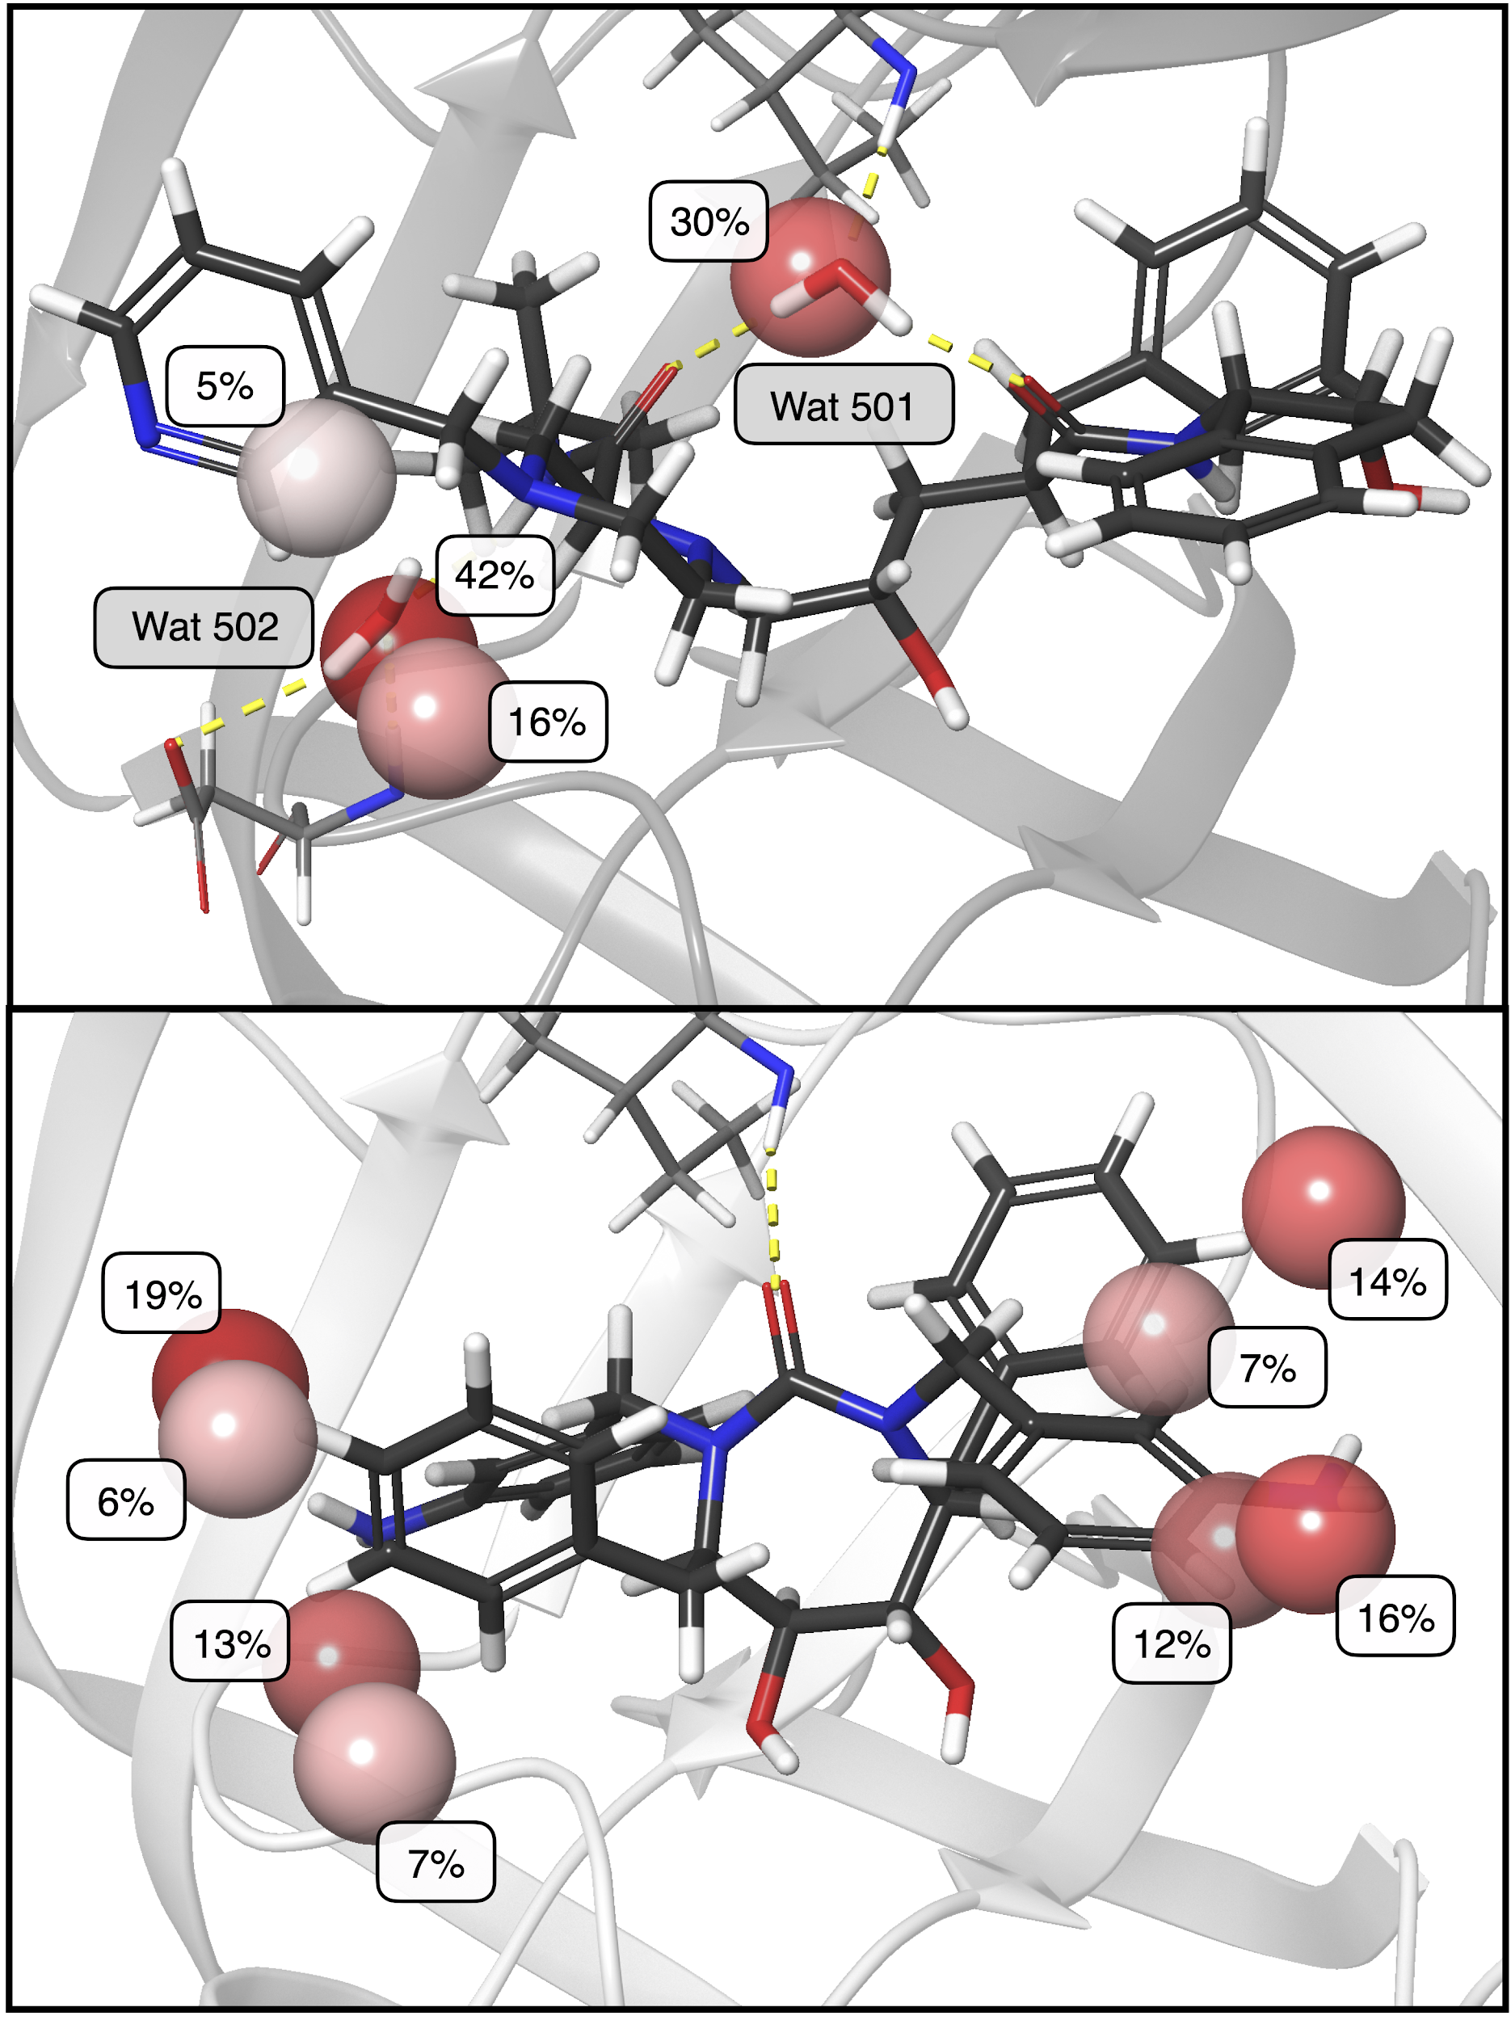
New Features
2. Water-PELE: a Monte Carlo-based algorithm to sample the effects of buried water molecules in proteins
Paper about to be released

Slide 22
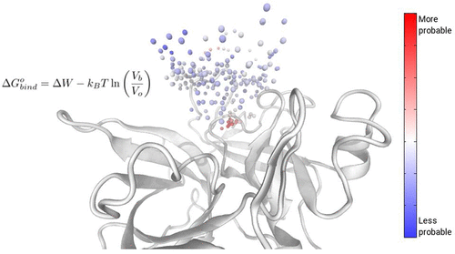
New features
3. MSM-PELE: Calculate “absolute” free energies
https://pubs.acs.org/doi/10.1021/acs.jctc.9b00753

Slide 23
HANDS ON PELE

Slide 24
Basics on PELE
System preparation + Simulation Input + Basic Analysis
https://nostrumbiodiscovery.github.io/nbd_central_docs/PELE/intro/intro.html

Slide 25
Tutorial 1: RORGamma
AdaptivePELE: Dissociation Path + Entrance Path (apo form)
https://nostrumbiodiscovery.github.io/nbd_central_docs/PELE/tutorial/RoRGamma/RoRGamma.html

Slide 26
Tutorial 2: MGluR5
Pose Prediction
https://nostrumbiodiscovery.github.io/nbd_central_docs/PELE/tutorial/Hemagglutinin/MGluR5.html

Slide 27
Tutorial 3: Hemagglutinin
Combination of AdaptivePELE and PELE:
Pocket Identification + Induced Fit
https://nostrumbiodiscovery.github.io/nbd_central_docs/PELE/tutorial/Hemagglutinin/Hemagglutinin.html

Slide 28
Tutorial 4: Esterases
PELE: Cavity creation
https://nostrumbiodiscovery.github.io/nbd_central_docs/PELE/tutorial/Esterases/Esterases.html

